Slide 1

Unit 1: Exploring Business

Slide 2

Starter
Consumers rely on businesses every day. Make a list of businesses, starting with any you have used this week. How many sell products? Which provide services? Compare your list with a peer. How many have you identified?
Let’s get started
Notes:
5 minutes/ 145 minutes

Slide 3

Lesson Objectives
Today you will learn…..
The functions and the role of money.
Why……
This will give you an understanding of money and attitudes towards it.
Notes:
3 minutes/ 142 minutes

Slide 4

Objective A – Explore the features of different businesses and analyse what makes them successful
Lesson A. Functions and role of money
Lesson B. Different ways to pay
Lesson C. Current accounts
Lesson D. Managing personal finance
Notes:
2 minutes/ 140 minutes

Slide 5

Explore the features of different businesses and analyse what makes them successful
Notes:
5 minutes/ 135 minutes
Partnership= comprising two or more people who set up in business together and share all profit and losses.
Economy- the state of a country, such as its wealth, production and consumption of goods and services.
Liability- an obligation of a company, or amounts owed to lenders and suppliers

Slide 6
Explore the features of different businesses and analyse what makes them successful
Most businesses rely on making a profit and the bigger the profit, the more successful the business. Although, remember that not every business measures its success by the amount of profit it makes. You will explore why that is a litter later. However, the way a business is organised to deliver its aims and meet the needs of its customer is critical to its success. In this unit you start to explore types of businesses and what influences success and failure.
Notes:
5 minutes/ 130 minutes

Slide 7
Features of Businesses
Another word for ‘feature’ is ‘characteristic’ or ‘attribute’; therefore business features comprise the characteristics that make up every organisation. For example, sole traders, such as a plumber or mobile hairdresser offering a service to customers who live locally. Other businesses might be very big and sell their products or services around the world, such as the BBC and Virgin Atlantic.
Notes:
5 minutes/ 125 minutes

Slide 8
Ownership and Liability
Businesses are owned in one of three ways:
Private
- Public
Not-for-profit
Notes:
5 minutes/ 120 minutes

Slide 9
Private
Private businesses are those owned by citizens and therefore they are liable for all aspects of the business. Owners of private businesses are likely to take many risks as they are in business to make a profit. Privately owned businesses can be of any size and owned by many partners. Some of the largest include:
Virgin
Mars
Tesco.
Notes:
5 minutes/ 115 minutes

Slide 10
Public
Public businesses which are identified as belonging to the public section are owned by the government or subsequently bought by the government from the private sector for investment or to save them from financial ruin, such as Northern Rock and the Royal Bank of Scotland. As the government is then liable for the success or failure of the business, they are less likely to take risks than businesses in the private sector because they aim to benefit the public.
Notes:
5 minutes/ 110 minutes

Slide 11
Not-for-profit
Businesses which do not aim to make a profit are often charitable organisations. Businesses often share many of the same features as private and public businesses, such as running on normal business lines, and have many paid workers but only seek to make enough money to cover running costs.
Voluntary organisations are also not-for-profit businesses. They are set up, organised and staffed by people working on a purely voluntary basis.
Notes:
5 minutes/ 105 minutes

Slide 12

Pause Point
Complete table of examples of business ownerships
Notes:
20 minutes/ 85 minutes

Slide 13
Privately Owned Businesses
Privately owned businesses can decide to become limited companies at any time. A decision to do so might be made to ensure that business profits and liabilities are properly shared based on the percentage of ownership by each of its directors. Business finances are kept separate from personal finances, therefore, if the business fails, owner’s personal assets, such as homes, cars, etc, cannot be used to pay off any debt.
Notes:
5 minutes/ 80 minutes

Slide 14
Owners of Limited Companies
Owners of limited companies have to pay corporation tax and can draw dividends from their business. Depending on personal tax liabilities, it may be beneficial to change the business structure to a limited company.
Some owners find they can increase their business opportunities by becoming a limited company as it may give the impression that they are larger or more established than they are. Some large organisations will only contract with limited companies
Notes:
5 minutes/ 75 minutes

Slide 15
Partnerships
Partnerships, such as the John Lewis Partnerships (JLP), may have many employees. Keep an open mind when exploring types of business and their features – not all estate agencies are private limited companies, just as not all accountants, dentists or solicitors are partnerships.
JLP is particularly interesting because it operates as a cooperative, although not in the formal sense. Cooperative contribute significant annual revenue (£37 billion) to the UK’s economy and are owned by nearly 15 million people. The word cooperative suggests working together, sharing aims and objectives which can be implemented in different ways and reward those cooperate in the business differently.
Notes:
5 minutes/ 70 minutes

Slide 16
Liability
To protect the business against the risk of being sued or held legally responsible, anyone owning or running a business should insure against such liability.
There are multiple insurance companies offering such as cover and, as with any insurance (for example, car or house insurance), they offer it at different rates and with different terms and conditions. Insurance for liability includes Public Liability Insurance and Directors’ and Officers’ Insurance (D&O).
Depending on the ownerships, size and type of business, the cover will also vary. You will explore this further throughout this unit
Notes:
5 minutes/ 65 minutes

Slide 17
Unlimited Liability
Some businesses are owned by sole traders or partnerships. If the owners share the business responsibilities equally, they are responsible not just for the profits but also the losses, such as debts and claims against the business. This means all owners are responsible for any shortfall of money if the business has insufficient funds. This could mean all savings and possessions including car, house, etc are at risk.
Notes:
5 minutes/ 60 minutes

Slide 18
Limited Liability
Where liability is limited, this means there is a limit (or cap) placed upon the amount that can be claimed. This type of liability might seem to be the obvious choice, but setting up in business is relatively easy and the risks attached can be overlooked, especially without the benefit of knowledge gained through studying.
Just as some insurance companies specialise in house, car or travel insurance, others specialise in business insurance and insurance for different types of businesses.
Notes:
5 minutes/ 55 minutes

Slide 19
Purposes
Most businesses supply products or services, or occasionally both. For example some businesses, such as dentist, provide a service and also sell a small range of products such as toothpaste, floss, toothbrushes, etc. Halfords provide products such as car and bicycle parts and they also provide a service whereby they fit windscreen wipers or bicycle tyres.
You could argue that all businesses are providing a service when selling or making their products

Slide 20

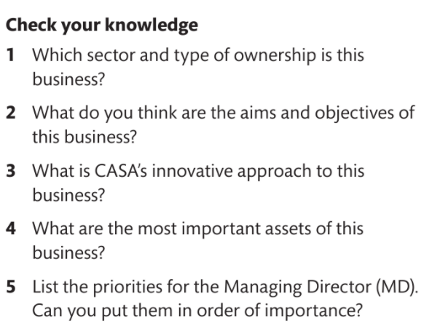
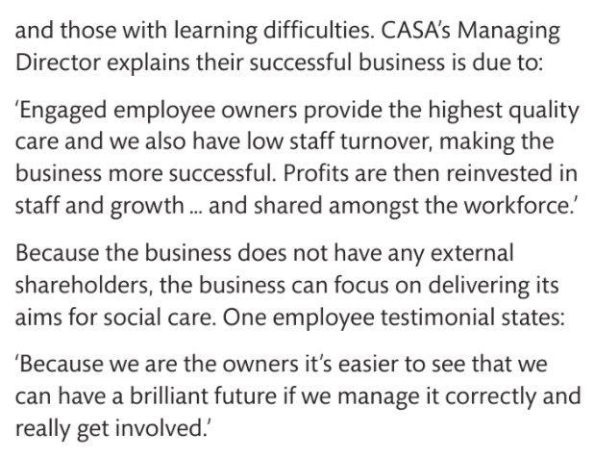
Pause Point- Case Study- Care in Crisis

Slide 21
Pause Point
Why is profit not the most important goal for this business?
Hint- without referring to the case study, list all the reasons that profit is not the main aim.
Extend- what non-financial rewards do employees receive from their involvement with this business?

Slide 22
Sectors
Businesses operate in different sectors according to the nature of their business and the product or service they provide. These sectors are known as primary, secondary, tertiary and quaternary and are the four stages of the journey from sourcing a material to being ready for the customer.
These terms also relate to the positioning of the business in relation to the customers’ requirements. Every sector and every type of business services customers.

Slide 23
Sectors
Businesses operate in different sectors according to the nature of their business and the product or service they provide. These sectors are known as primary, secondary, tertiary and quaternary and are the four stages of the journey from sourcing a material to being ready for the customer.
These terms also relate to the positioning of the business in relation to the customers’ requirements. Every sector and every type of business services customers.

Slide 24
Primary Sector
  Lets take an example of a customer such as a builder who requires the roof trusses for a house – the builder relies on the primary sector to source the raw materials and on the secondary sector to prepare those materials from their raw state so that they can form the frame for a roof

Slide 25
Secondary Sector
  The secondary sector processes the raw materials produced by the primary sector so that they can be sold on. For example, farmed vegetables, mined diamonds or coal, felled wood and caught fish, all need to be prepared or manufactured in some way by the secondary sector so that they are fit for sale.

Slide 26
Tertiary Sector
  This sector provides the supporting services which store and distribute the goods which have been manufactured. It also provides insurance against, for example, damage or possibly late delivery. Businesses often rely on advertising to promote their products- another service provided by the tertiary sector. The tertiary sector also sells skills support such as training for staff, for example for people who clean and pack vegetables to sell in shops and supermarkets. Types of tertiary business include services such as travel and tourism, entertainment, education and training, and transport.

Slide 27
Quaternary Sector
  Together with the tertiary sector, employees working in the quaternary sector currently account for 75% of the UK workforce. This sector also provides support services and can appear to overlap the tertiary sector. Examples include the communications infrastructure for day to day operations, such as telephoning and emailing.
  The quaternary sector could be seen as the beginning and the future of every business as this sector includes the research and development stage. Therefore this fourth (quaternary) sector relies on information from other sectors to test existing products and methods, and to develop new ways of sourcing and producing new products or approaches.

Slide 28
Quaternary Sector
  Together with the tertiary sector, employees working in the quaternary sector currently account for 75% of the UK workforce. This sector also provides support services and can appear to overlap the tertiary sector. Examples include the communications infrastructure for day to day operations, such as telephoning and emailing.
  The quaternary sector could be seen as the beginning and the future of every business as this sector includes the research and development stage. Therefore this fourth (quaternary) sector relies on information from other sectors to test existing products and methods, and to develop new ways of sourcing and producing new products or approaches.

Slide 29
Local
  The scope of a business means the range covered by that business. Earlier we looked at the features of businesses and suggested that some business types are more likely to offer their services locally, for example mobile hairdressers, plumbers and gardeners. A local business is usually one which is owned locally and serves just the local area, such as an independent village ship or perhaps a pub which is owned by local residents. There are, of course, exceptions and you could probably identify some. Some local businesses, such as your local council office, are part of a much bigger organisation although they provide a service to the local area.

Slide 30
National
  You probably use businesses which operate nationally fairly frequently and possibly have not considered this before. Some could appear to be a local business (especially if you are served by the same staff) but the business might be a franchise.
  You may know some franchised businesses in your area, for example Harvey’s Furniture Store, Kwik Fit and possibly one of the most well known, McDonalds.
  The government defines a franchise as ‘the owner of an established business format (the franchiser) grants to another person (the franchisee) the right to distribute products or perform services using that system’ and a fee is paid to the franchiser according to the terms of their agreement,

Slide 31
International
  International business do business transactions that take place across national boarders. Since the birth of the internet, international business has provided with worldwide opportunities to sell products and services. Since the first email was sent in the early 1970s and the internet became widely available from 1990, the world appears to have become smaller and certainly more accessible.

Slide 32
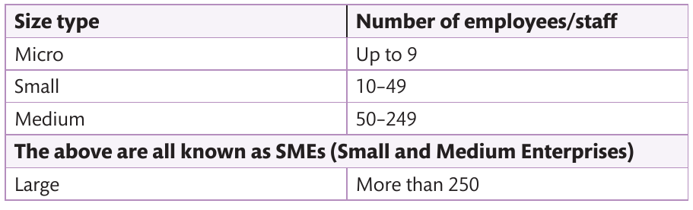
Measuring the Size of a Business
  So far, this unit referred to businesses of different sizes as small or large. To accurately quantify the size of a business, strict definitions exist and these are outlined below
  The UK parliament publishes reports on the contribution businesses have made to the economy. According to the data supplied by BIS in its Business Population Estimates (2014) there were 4.9 million businesses in 2013, which increased to 5.2 million in 2014. More than 99% were SMEs and employed almost 14.5 million people, contributing to almost half of the UK economy. The number of micro businesses also rose slightly to 5 million

Slide 33
Reasons for Success
  Earlier, the concept that not every business measures success by the amount of profit made was introduced. There are different reasons for success depending on the type of business (profit or non-profit) and its aims and objectives, which you will explore shortly.

Slide 34
Profit Seeking Business
  Businesses seeking to make a profit are motivated by various reasons. For example, to pay the bills for everyday living, have money for extras and realise some aspirations such as owning your own home, buying a nice car, having holidays, etc.
  As businesses get larger they generate more responsibility. For example, a growing business might employ additional staff, pay for premises and develop products or services to expand on its market share so the business can continue to grow. Managing the profits becomes more complex and specialised.
  Just because a business grows it does not automatically follow that it becomes more profitable. This is because its costs might increase and the interest rates paid on loans or investments could fluctuate. Sometimes businesses call on the services of other sectors, for example for specialist financial advice from a consultancy service (perhaps on running the business more efficiently to make more profit and reduce costs).

Slide 35
Non-Profit Seeking Business
  The primary goal of these businesses is not to make substantial profits but enough to continue the business. Therefore they also need to keep a very close eye on their finances to ensure that what they spend does not exceed the income they receive, known as revenue.
  Revenue is not necessarily gained from selling a product or service but could come from successful bids for funding or grants, donations from members of the public or perhaps lottery funding. Example include:
  Donations for The Royal National Lifeboat Institution (The RNLI)
  Lottery funding for causes such as sports and the arts
  Cultural heritage groups, such as those celebrating the 70th anniversary of the end of the Second World War.

Slide 36
Aims and Objectives
  Every business needs aims and objectives- just as every lesson you attend has aims defining the purpose and outcome of the lesson and objectives which identify how to achieve the aim. Although these aims and objectives might be less formal in a micro business, every business must have a purpose and outcome. You will have your own aims and objectives and a plan of some sort identifying how you are going to get there.

Slide 37
Clarity of Vision
  Just as your plan will change and a tutor’s plan can change, so will the aims and objectives of a business. These changes are influenced by market forces, for example customers’ needs. Market forces help a business to focus on its direction and how it an continue to operate. In other words, they are designed to provide clarity of vision without this it is unlikely that the business will succeed.
  Think about an experience you have had with a business where you have been confused about its purpose or got the impression that the business had no direction. For example, think about whether it would make business sense to set up a market stall selling sportswear and other unrelated products, for example toiletries.

Slide 38
Innovative Products or Processes
  Innovative products, or creative ways to go about a process, can lead to business success. Examples include Mad Marc’s idea to enthuse children in science, child innovators of the Crikey Bikey harness and Rob Law’s Trunki.
  Having a great idea for an innovative product or idea is a good start. But your perception of a great product or idea may not be someone else’s. what makes good business sense is to be creative- employers are always looking for employees who can think for themselves and propose more efficient ways to manage a process or identify innovative products or services.

Slide 39
Stakeholders and Their Influence
  Every business has stakeholders. You may have heard the term used before but you will now learn what it actually means and look at who the various stakeholders in a business are.

Slide 40
Stakeholders
  There are two types of stakeholders, internal and external. In other words, those within the business, such as its employees and those outside the business, including customers and anyone else with an interest in the business. They all have a stake in the business.

Slide 41
Internal
  The internal stakeholders include:
  Managers (decision makers and bosses)
  Employees (reporting to managers)
  Owners (overall responsibility for the business).
  Therefore every sector has internal stakeholders although, for example, a sole trader will not have managers and employees.

Slide 42
External
  Businesses also have external stakeholders. Without them they wouldn’t have a business. These stakeholders are described in the next slides.

Slide 43
Suppliers
  Suppliers supply raw materials. Examples include bricks supplied to builders, electricity to light our homes and streets, fabric to manufacturer our clothes etc.

Slide 44
Lenders
  These are stakeholders who lend money or possibly services to the business, such as start up business loans. These loans are available through banks and other sources such as government loans. Other loans might include a mortgage for the business premises for those owners who don’t want to rent premises.

Slide 45
Competitors
  Anyone who is in competition with a business is also referred to as a stakeholder. In order to operate a successful business, you will need to know who your competitors are and what they are offering. This enables a business owner to be better informed about the choices they can make and whether a change of direction is required, or if an opportunity is arising due to a gap in the market. One such example is the supermarket chain Lidl UK. They identified a need for competitively priced food that does not compromise on taste, as claimed by their adverts.

Slide 46
Debtors
  Every business has debtors, although this does not mean all businesses run without making a profit. A debtor is any person or organisation which owes money to the business. The financial crisis in Greece may well have made you familiar with the term debtor in relation to a country which owes money. If you have been given a period of time to pay for a product or service you have received, you are a debtor of that business.

Slide 47
Creditors
  Just as every business has its debtors, it will also have creditors. Creditors are those to whom money is owed, and this may be an individual or another business. If you take the example of raw materials supplied to a business, the supplier becomes a creditor of the business until they have paid for the materials.

Slide 48
Customers
  Businesses have both internal and external customers. Everyone can relate to being an external customer whether enquiring about or purchasing a product or service such as an item of clothing, a train ticket or a haircut. You are also a customer when you receive a service for which no money changes hands, such as hospital treatment or careers advice. The last point is especially interesting because, while an external customer might not be required to pay for a service, payment for that service will still come from somewhere, such as government funding. Basically, an external customer is someone who brings revenue into the business.

Slide 49
Customers
  Internal customer include anyone directly related to the business. They include employees of a business whether they are physically present in that business or are representatives of the organisation. For example, historically, the majority of sales personnel travelled around promoting and selling their company’s wares for the majority of their time. This type of customer has changed significantly over the last years due to developments in technology that reduce the need for travel, for example email and the internet.

Slide 50
Customers
  Internal customer also include employees working in different departments and those working at different sites. They also include suppliers who are crucial to the operation of the business. A successful business relies on everyone working together harmoniously, therefore it is important you recognise that we are all customers of each other. In other words, we become a team, relying on each other’s knowledge, strengths and expertise. Having this philosophy leads to greater job satisfaction as everyone has a stake in the business.

Slide 51
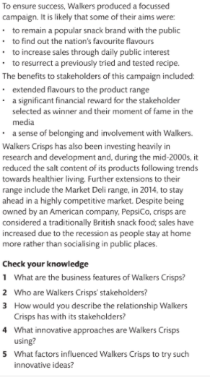
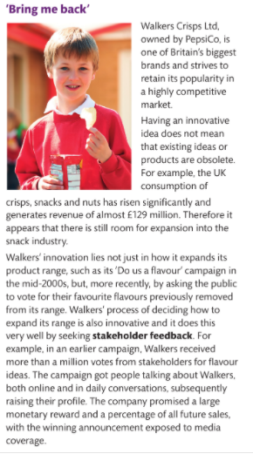
Pause Point- Case Study- ‘Bring me Back’

Slide 52
Pause Point
Which aspects of this case study did you find most interesting and why? What new information have you learned?
Hint- identify a different type of business and explore how they involve stakeholders to develop their product range.
Extend- consider other reasons for the success of these businesses based on factual information

Slide 53
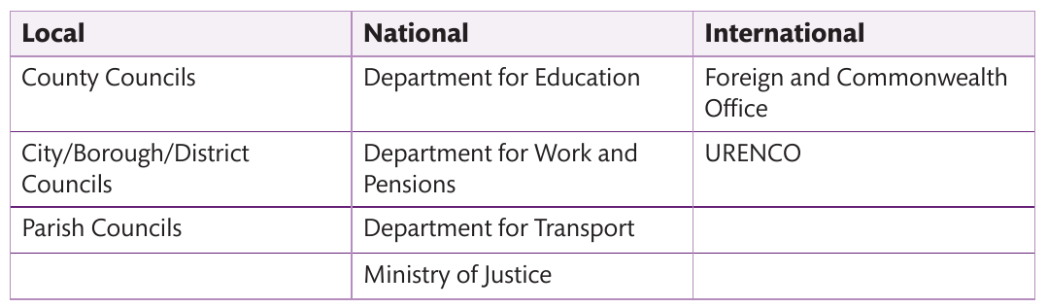
Government Agencies and Departments
Other external stakeholders include government agencies and departments, which may be local, national or international. Some example of government departments have been mentioned already, such as Department for Business, Innovation and Skills. Other examples of agencies and departments are outlined on the below.

Slide 54
Government Agencies and Departments
  Local government includes your local council. In some areas there are two councils, for example in Leicestershire, where they have a county council and a city council. Each of these councils are responsible for services which affect the whole county, such as education, roads, planning, fire and safety, etc.
  London boroughs each have a council and the metropolitan area has another. District councils are responsible for the detail of how, for example, rubbish collections are organised and how the council tax is structured. You may have a parish or community council which deals with very local matters such as allotments and street lighting. Each has a stake in the business and the community, for example to ensure houses are not built on farmland unless permission is granted.

Slide 55
Government Agencies and Departments
  Each government department works with a number of agencies. If you take the example of the Department for Education, a national department working with nine agencies (including Ofsted), they have a stake in your education and provide the funding for your schooling and possibly your education still.
  An example of international government is the Foreign and Commonwealth Office. It is responsible for: promoting the UK; working with other countries to seek ways to increase our economy; reporting on global developments and travel; informing policy.
  Government has a stake in businesses and also informs and legislates how businesses must operate. Government rules and regulations and constantly changing and businesses can find it difficult to keep up to date.

Slide 56
Communities
  Just as government operates locally, nationally and internationally, so do our communities. You may know of examples where a community has influenced a new or existing business. For example, members of a community may become involved in the operation of a business such as a training centre or a post office, working in partnership with communities.

Slide 57
Pressure Groups
  Communities can take on small and large projects and put considerable pressure on whether a business proposition will succeed or fail. For example, a farmer who proposed to sell some of his land to a developer for a crematorium but met with opposition.
  Another example is where communities nationally have placed pressure upon the government to reconsider their plans for the high speed railway (HS2). Longstanding pressure groups exist on a larger and longer-standing scale, such as:
  Animal rights activists
  Amnesty international
  Greenpeace
  Christian Aid

Slide 58
Interest Groups
  These groups include members with an interest in a business or specific businesses who strive for a common cause. They look to influence the business or factors such as policy or regulators. These include:
  Trade unions
  Chambers of commerce
  Professional associations such as those representing:
  Accountants
  Doctors
  Lawyers
  Architects

Slide 59
The Influence of Stakeholders on Business Success
  Stakeholders can influence business success. Earlier, you read about the London Stock Exchange where public limited companies (plcs) offers shares in the company. This raise funding for the business by selling off parts of it as shares. Shareholders are looking for value for money; in business terms this is called shareholder value.
  As you probably know, the value of these shares can go down as well as up and therefore shareholders are keen to ensure their investment is worthwhile. This can create a tension between those who run the business and those who simply have an interest in it. Shareholders vote on proposals for the ways the business is run which depends on majority votes.

Slide 60
The Influence of Stakeholders on Business Success
  Customers are also stakeholders and should be considered as long-term assets. Customers who feel valued and receive good service are more likely to remain loyal. Strong customer service, such as that provided by M&S, Waitrose and JLP, enables customer retention.
  Surprisingly, some businesses are constantly chasing new business and overlook the power of using their existing customer base by retaining their customers. Some businesses make assumptions that if a customer has just purchased a product or service they may not purchase again for a while, if at all. You can probably give examples of businesses who promote special offers to ‘brand new customers only’.

Slide 61
Employee Involvement
  As employees are stakeholders of the business they contribute to the success of the business, whether it is as a direct or indirect result of their actions.
  Some businesses have employee contribution schemes, such as JLP, Waitrose, Brompton Bikes and Dyson. In a similar way, you place of study will seek feedback form its employees as well as its students. Suggestions and recommendations can indirectly impact on the success of a business by initiating ideas.
  In the early 20th century, a shop assistant in a major department store in New York suggested to a customer that they visit their main competitor when they could not supply the item sought. Despite opposition from the management, the sales in this store increased as a direct result and, subsequently, other stores followed the example.

Slide 62
Corporate Social Responsibility
  Often shortened to CSR, corporate social responsibility means the contribution that a business has committed to make to society and the environment. To deliver such a commitment, employees are encouraged to volunteer in a community project and work with community groups. The business might allocate the equivalent of one day a year to such an activity. Several major businesses are known for this strategy.

Slide 63
Corporate Social Responsibility
  As consumers, we are probably made more aware of our responsibilities to society and environment than ever before. There are businesses which alert public interest, such as the nuclear industry, and others which may be of particular interest to you, such as endangered species. It is probably unlikely that you can avoid daily media interest about local or global examples of poverty or waste or damage to the environment.
  Interest groups influence and support CSR strategies. One such example is the Banyan Tree Resort which endeavours to protect the environment by investing in research projects and educating visitors to their resort.

Slide 64
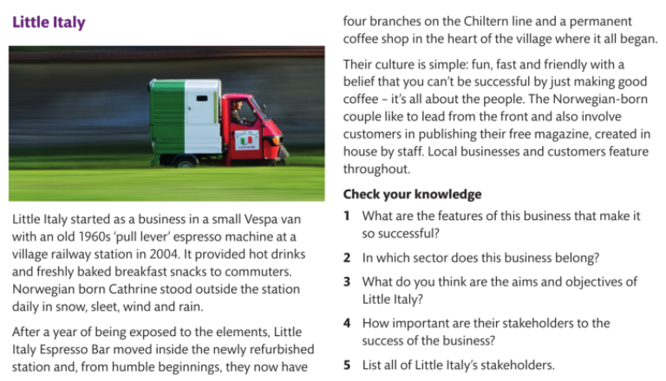
Pause Point- Case Study- Little Italy

Slide 65
Effective Business Communication
  Without effective business communications, a business is unlikely to succeed. Since the latter part of the 20th century, people have relied on the introduction and development of digital communications and, as you will explore shortly, these require a different approach to how to communicate with the diverse audiences with which businesses need to engage.

Slide 66
Effective Business Communication
  While English is widely spoken around the global, it is too easy to assume that everyone understands exactly what we mean. For example, a simple message shown in the first column on the next slide might be clear, but the message written in slang in the second column could be difficult for a UK resident to interpret, let alone an overseas customer. The interpretation shown in the third column might be clear, but is it appropriate in a business context?

Slide 67
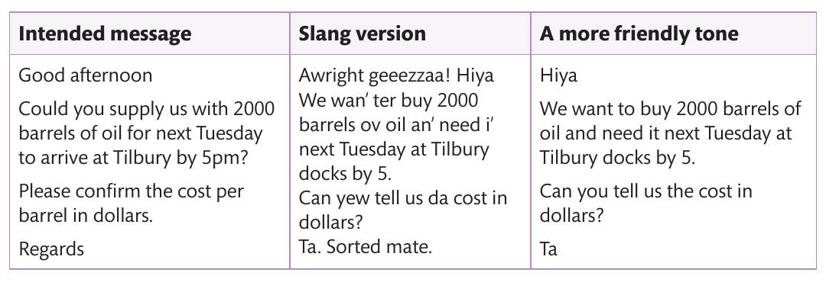
Effective Business Communication
Notes:
The example shows possible differences in dialect in just a small part of the UK. Consider how many other differences there are in the way people speak because of geographical diversity alone.
Although the message might be understood, the way in which it is conveyed might be not be received so well. It is important to use the right language for the right audience to get the right result. Everyone uses different ways of speaking depending on who they are communicating with and the method they are using to convey the message

Slide 68
Appropriate Presentation and Delivery of Information to a Given Audience
  You may have been asked to give a presentation to your tutors and classmates in school or college. If you have a part-time job, consider how often you have been required to give a presentation to colleagues or managers. In this situation, it is possible you would be told what format is required.
  However, if you have been asked by a family member to explain something to them or describe an idea, the way you present it to them is likely to be very different. In a business context, you may be required to produce a written report, presentation of slides or use a flip chart and pens to explain a concept. It is highly unlikely that any of these methods will be needed with family or close friends where you are communicating on a more informal basis. Yet people tend to associate a presentation with an electronic output.

Slide 69
Written Presentations
  In business, presentations take place almost continually. Reports can be formal, for example those which deal with business matters relating to finance or policy, such as government reports. A finance department (which may comprise just one or two people n a SME) will routinely produce a set of written monthly accounts as a formal report.

Slide 70
Written Presentations
  While electronic software is probably used to produce the financial accounts and the report, an explanation of what the figures actually mean will be more appropriate than providing lots of graph or colourful slides. This means that the accounts need to be explained in a different format so that others can understand them clearly. This could be informal, for example by using a flip chart, or talking others through the information. Informal reports can also describe progress on a project or idea. In this case, the language will reflect a less formal and less business-like approach.
  With all written presentations it is important that the information provided is accurate and presented in an appropriate format.

Slide 71
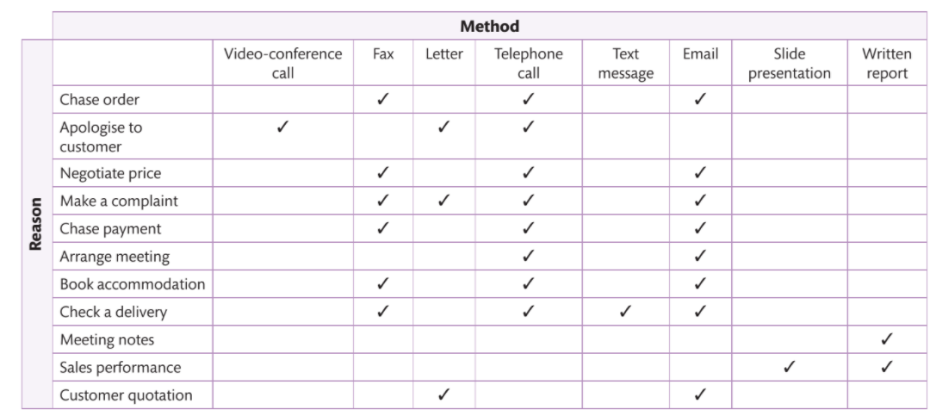
Written Presentations
Example of ways to communicate in business

Slide 72
Written Presentations
  Video conferencing may be used to present some reports, especially where employees are unable to attend one site or always work cross-site. Faxes are used infrequently these days but do still exist, especially overseas or in remote locations where internet connection is less reliable

Slide 73
Oral Presentations
  Presentations are often accompanied by a speaker, where professional presenting software is used. This is because each slide should only provide a headline account, with the detail explained by the presenter. Presentations are especially useful when communicating to larger audiences or when giving a series of presentations. They may be accompanied by speaker notes.

Slide 74
Oral Presentations
  It is important to consider the purpose of communicating and whether the language used needs to be adapted to different audiences. For example, technical language is understood by a specialist, such as mechanical engineer or IT technician, but it needs to be adapted if you are proposing changes to a network system to non-expert users of that system.

Slide 75
Importance of Communication to Aid Business Success
  Social media can be a great way of promoting a small business and getting it known across a wider community (like Little Italy promoting its services to customers through its website and newsletter). Regardless of business size, social media is being used more widely each year and those dominating business communications include LinkedIn, Instagram, Facebook and Twitter. Government offices also rely on social media. Although there are reservations about using social media, it ca recap rewards if it used responsibly.

Slide 76
Importance of Communication to Aid Business Success
  Social networks which develop through the use of social media become virtual communities, spanning diverse geographic locations and ignoring political boundaries. Less obvious examples of virtual communities include those initiated by inventor James Dyson and Brompton Bikes.
  These virtual communities can thrive on common interests and develop fresh ideas, extend knowledge and be useful for business owners who are considering ways to expand or even start up a business. Virtual communities can make or break a business and word can travel fast. Sites as TripAdvisor use virtual communities for gathering reviews from customers on their experiences.

Slide 77
Importance of Communication to Aid Business Success
  Some businesses, such as Microsoft, use discussion boards to generate ongoing interaction whether to promote a product or service, or to report or solve problems. Sites such as Educator Network evolved to bring tutors together across the globe to share their teaching and training ideas and challenges. They have helped to provide innovative ways to teach ‘hard to learn’ topics and better understand cultural diversity.

Slide 78
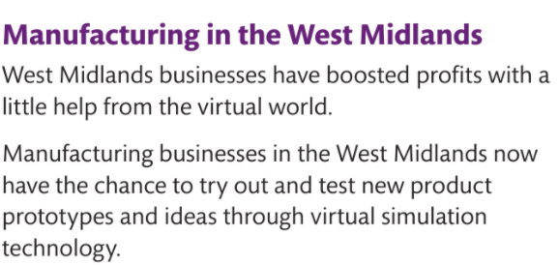
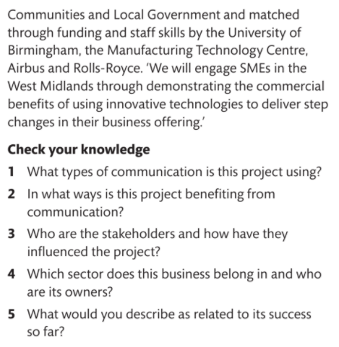
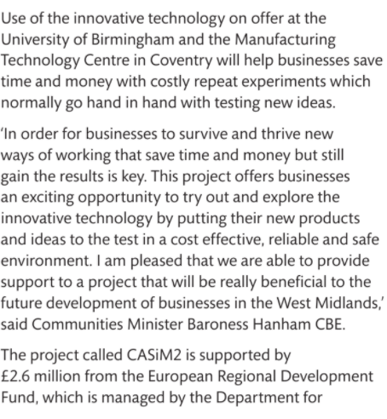
Pause Point- Manufacturing in the
West Midlands

Slide 79
Lesson Summary
Plenary
Write a paragraph what you have learnt today.
The best one I will be putting it on my PowerPoint slide- as a recap for the next lesson.
Here is what we learned
Notes:
5 minutes

